Slide 1
Non-regular languages
(Pumping Lemma)

Slide 2
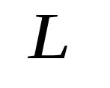
How can we prove that a language
is not regular?
Prove that there is no DFA or NFA or RE
that accepts
Difficulty: this is not easy to prove
Solution: use the Pumping Lemma !!!

Slide 3

The Pigeonhole Principle

Slide 4
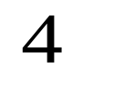

pigeons
pigeonholes

Slide 5
A pigeonhole must
contain at least two pigeons

Slide 6

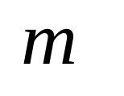

pigeons
...........
pigeonholes
...........

Slide 7
The Pigeonhole Principle
pigeons
pigeonholes
There is a pigeonhole
with at least 2 pigeons
...........

Slide 8
The Pigeonhole Principle and
DFAs

Slide 9



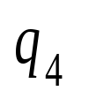


Consider a DFA with states

Slide 10

Consider the walk of a “long’’ string:
(length at least 4)
A state is repeated in the walk of

Slide 11
The state is repeated as a result of
the pigeonhole principle
Walk of
Pigeons:
(walk states)
Are more than
Nests:
(Automaton states)
Repeated
state

Slide 12

Consider the walk of a “long’’ string:
(length at least 4)
Due to the pigeonhole principle:
A state is repeated in the walk of

Slide 13
The state is repeated as a result of
the pigeonhole principle
Walk of
Pigeons:
(walk states)
Are more than
Nests:
(Automaton states)
Automaton States
Repeated
state

Slide 14
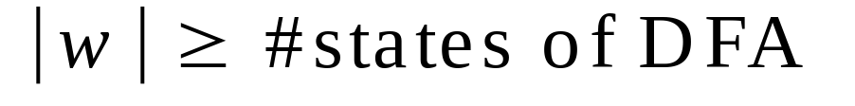
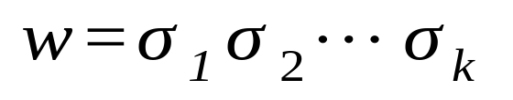






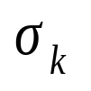


In General:
If ,
by the pigeonhole principle,
a state is repeated in the walk of w
Walk of
....
....
....
Arbitrary DFA
......
......
Repeated state

Slide 15
The Pumping Lemma

Slide 16
Take an infinite regular language
(contains an infinite number of strings)
There exists a DFA that accepts
states

Slide 17
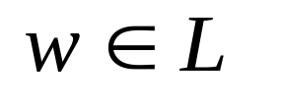
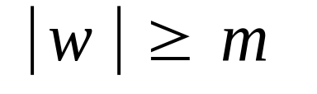
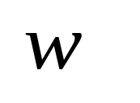

Take string with
(number of
states of DFA)
then, at least one state is repeated
in the walk of
Walk in DFA of
......
......
Repeated state in DFA

Slide 18
There could be many states repeated
Let be the first state repeated
First
occurrence
Second
occurrence
....
....
....
Unique states

Slide 19
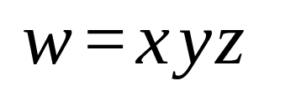

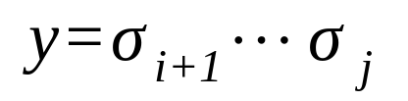
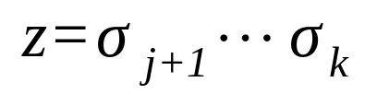
We can write
First
occurrence
Second
occurrence
....
....
....

Slide 20



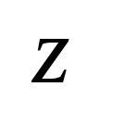
In DFA:
contains only
first occurrence of
...
...
...
...

Slide 21
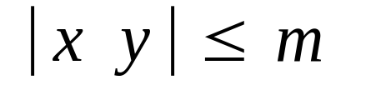
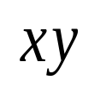
Observation:
length
number
of states
of DFA
...
...
Unique States
Since, in no state is
repeated except q

Slide 22
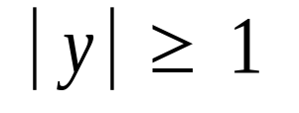
Observation:
length
Since there is at least one transition
in loop
...

Slide 23
We do not care about the form of string
may actually overlap with the paths of and
...
...

Slide 24
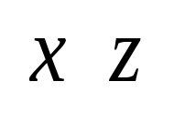
Additional string:
The string
is accepted
Do not follow loop
...
...
...
...

Slide 25

Additional string:
The string
is accepted
Follow loop
2 times
...
...
...
...

Slide 26
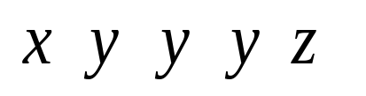
Additional string:
The string
is accepted
Follow loop
3 times
...
...
...
...

Slide 27
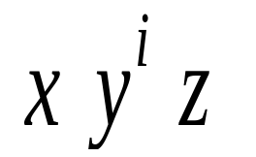
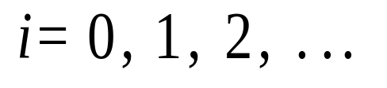

In General:
The string
is accepted
Follow loop
times
...
...
...
...

Slide 28
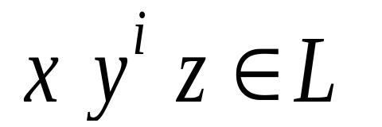
Therefore:
Language accepted by the DFA
...
...
...
...

Slide 29
In other words, we described:
The Pumping Lemma !!!

Slide 30
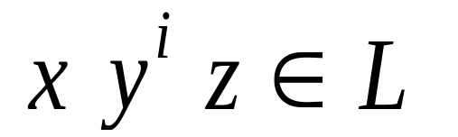
The Pumping Lemma:
Given a infinite regular language
there exists an integer
(critical length)
for any string with length
we can write
with and
such that:

Slide 31
The Pumping Lemma
Let L be a regular language. Then there is a constant m (the number of states of minimum FA) where, if w is any string in L of length at least m, then w may be divided into three parts, w=xyz, satisfying the following conditions:
  y ≠ε (but x and z may be ε)
  |xy| ≤ m
  for each i ≥ 0, xy^{i}z ∈ L

Slide 32
Applications of the Pumping Lemma

Slide 33
Observation:
Every language of finite size has
to be regular
(we can easily construct an NFA
that accepts every string in the language)
Therefore, every non-regular language
has to be of infinite size
(contains an infinite number of strings)

Slide 34
Suppose you want to prove that
An infinite language is not regular
1. Assume the opposite: is regular
2. The pumping lemma should hold for
3. Use the pumping lemma to obtain a
contradiction
4. Therefore, is not regular

Slide 35
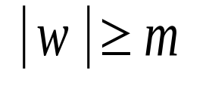
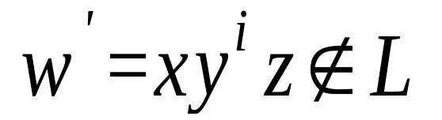
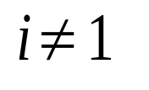
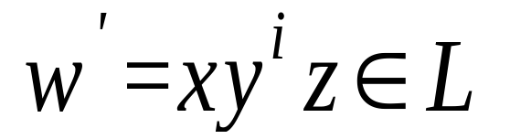
Explanation of Step 3: How to get a contradiction
1. Let be the critical length for
2. Choose a particular string which satisfies
the length condition
3. Write
4. Show that
for some
5. This gives a contradiction, since from
pumping lemma

Slide 36
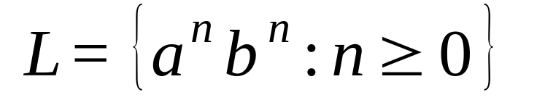
Example of Pumping Lemma application
Theorem:
The language
is not regular
Proof:
Use the Pumping Lemma

Slide 37
Assume for contradiction
that is a regular language
Since is infinite
we can apply the Pumping Lemma

Slide 38
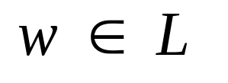
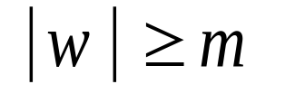
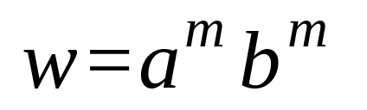
Let be the critical length for
Pick a string such that:
and length
We pick

Slide 39
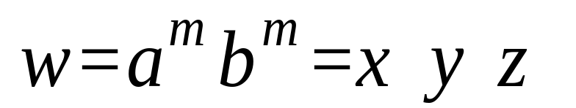
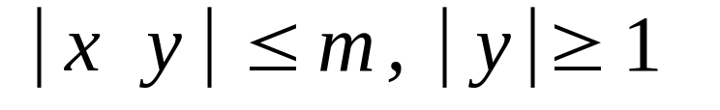
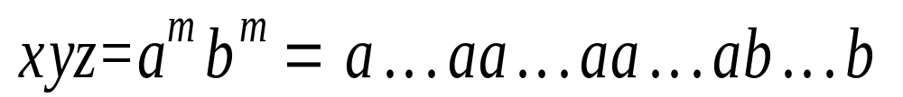

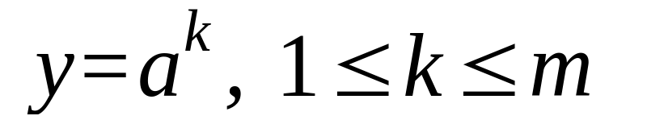
From the Pumping Lemma:
we can write
with lengths
Thus:

Slide 40
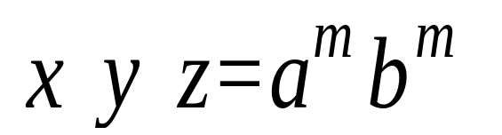
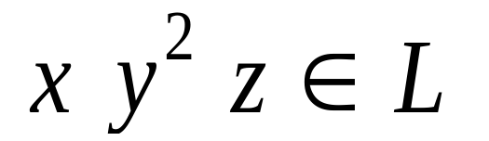
From the Pumping Lemma:
Thus:

Slide 41

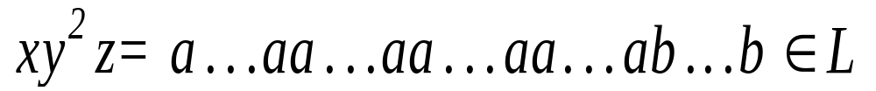
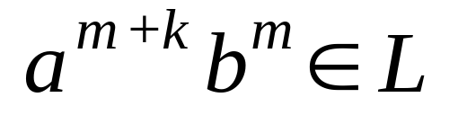
From the Pumping Lemma:
Thus:

Slide 42
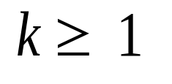
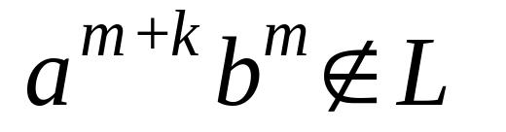
BUT:
CONTRADICTION!!!

Slide 43
Therefore:
Our assumption that
is a regular language is not true
Conclusion:
is not a regular language
END OF PROOF

Slide 44
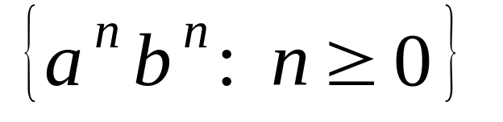
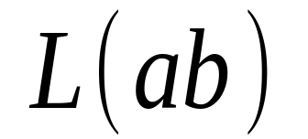
Non-regular language
Regular languages

Slide 45
Closure Properties of Regular Languages
We have seen that some languages are not regular
On the other hand, certain operations on regular languages are guaranteed to produce regular languages.
  The following theorems are referred to as the closure properties of regular languages.
  Closure refers to some operation on a language, resulting in a new language that is of the same “type” as those originally operated on, i.e., regular.

Slide 46
Closure Properties of Regular Languages
The union of two regular languages is regular.
The intersection of two regular languages is regular.
The compliment of a regular language is regular.
The difference of two regular languages is regular.
The reversal of a regular language is regular.
The kleene closure(star) of a regular language is regular.
The concatenation of regular languages is regular.
A homomorphism of a regular language is regular.
The inverse homomorphism of a regular language is regular.

Slide 47
Closure under Union
Let L and M be languages over ∑. Then L ∪ M is the language that contains all strings that are either in L or in M.
  We have already shown how to compute R+S, where R+S is the union of two regular languages. If L=L(R) and M=L(S) then L(R+S) is the same as L ∪ M.
  Note that if ∑ is different for L and M, then ∑ for (L ∪ M) is the union of the alphabets for L and the alphabets for M.

Slide 48

Closure under Complementation
Let L and M be languages over ∑. Then is the complement of L, which is the set of strings of ∑* that are not in L.
In other words, the complement of a language is everything that is not accepted by the language over our alphabet. Here is an argument as to why complementation is closed. To complement a language:
  First construct a DFA for that language
  Complement the accepting states of the DFA
  Note that this requires there be no missing transitions in the DFA. If the automaton “dies” on missing edges, these states will be missing from the complemented DFA (which should be accepting states).

Slide 49
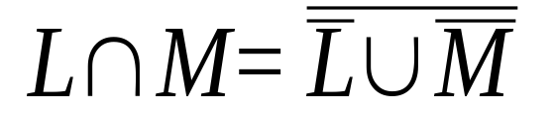
Closure under Intersection
Let L and M be languages over ∑. Then L ∩ M is the language that contains all strings that are both in L and M.
To show closure under intersection, note DeMorgan’s law which states:
We have already shown closure under union and complementation, therefore we also have closure under intersection.

Slide 50
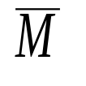
Closure under Difference
Let L and M be languages over ∑. Then L – M, the difference of L and M, is the set of strings that are in L but not in M.
To show closure, note that: L – M = L ∩ . Since we have shown closure under intersection and complementation, we also have closure under difference.

Slide 51
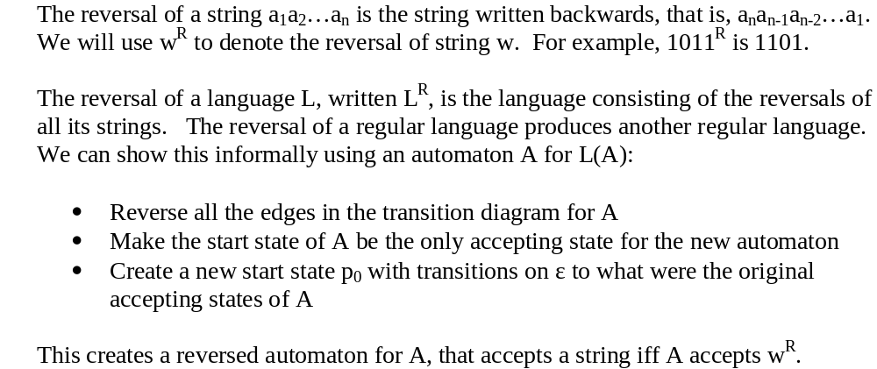
Closure under Reversal

Slide 52
Closure under *, Concatenation
Closure under Kleene Star
  We have already shown this for regular expressions in the construction of an equivalent ε-NFA for the star operation.
Closure under concatenation
  We have already shown this for regular expressions in the construction of an equivalent ε-NFA for concatenation.

Slide 53
Closure under Homomorphism
What is a homomorphism?
  Given a language L with alphabet ∑1, A homomorphism h is defined from some alphabet ∑2. For symbol(s) a ∈ ∑1, h(a) is some string from ∑2.
    We apply h to each symbol of a word w from L and concatenate the results in order to get a new string. h(L) is the homomorphism of every word in L.
  Example: h is the homomorphism from the alphabet {0,1,2} to the alphabet {a,b} defined by h(0) = a, h(1) = ab, h(2) = ba.
    h(0120) = aabbaa
    h(21120) = baababbaa
    h(01*2) = a(ab)*ba

Slide 54
Closure under Homomorphism
Theorem: If L is a regular language over alphabet ∑, and h is a homomorphism on ∑, then h(L) is also regular.
  Informally, if L is turned into a regular expression, we are substituting a regular expression for some other regular expression matching the homomorphism. The result is still a regular language.
  Note: we can expand homomorphisms to more general substitution, where substituting a substring in L (instead of an individual symbol) with some new string also results in a language that is regular.

Slide 55
Inverse Homomorphism
A homomorphism may be applied backwards; i.e. given the h(L), determine what L is. This is denoted as h⁻¹(L), or the inverse homomorphism of L, which results in the set of strings w in ∑* such that h(w) is in L.
  Note that while applying the homomorphism to a string resulted in a single string, we may get a set of strings in the inverse.
  For example, if h is the homomorphism from the alphabet {0,1,2} to the alphabet {a,b} defined by h(0) = a, h(1) = ab, h(2) = ba.
    Given L is the language {ababa} what is h⁻¹(L) ?
    We can construct three strings that map into ababa:
    h⁻¹={ 022, 110, 102 }
    The result of h⁻¹ is also a regular language (see proof in book).

Slide 56
Decision Properties of Regular Languages
Given a (representation, e.g., RE, FA, of a) regular language L, what can we tell about L?
Since there are algorithms to convert between any two representations, we can choose the representation that makes whatever test we are interested in easiest.

Slide 57
Decision Properties
Membership: Is string w in regular language L?
  Choose DFA representation for L.
  Simulate the DFA on input w.
Emptiness: Is L = Ø?
  Use DFA representation for L
  Use a graph-reachability algorithm (e.g. Breadth-First-Search or Depth-First-Search or Shortest-Path) to test if at least one accepting state is reachable from the start state. If so, the language is not empty. If we can’t reach a accepting state, then the language is empty.

Slide 58
Decision Properties
Finiteness: Is L a finite language?
  Note that every finite language is regular (why?), but a regular language is not necessarily finite.
  DFA method:
    Given a DFA for L, eliminate all states that are not reachable from the start state and all states that do not reach an accepting state.
    Test if there are any cycles in the remaining DFA; if so, L is infinite, if not, then L is finite. To test for cycles, we can use a Depth-First-Search algorithm. If in the search we ever visit a state that we’ve already seen, then there is a cycle.

Slide 59
Decision Properties
Equivalence: Do two descriptions of a language actually describe the same language? If so, the languages are called equivalent.
  For example, we’ve seen many different (and sometimes complex) regular expressions that can describe the same language. How can we tell if two such expressions are actually equivalent?
To test for equivalence our strategy will be as follows:
  Use the DFA representation for the two languages
  Minimize each DFA to the minimum number of needed states
  If equivalent, the minimized DFA’s will be structurally identical (i.e. there may be different names for the states, but all transitions will go to identical counterparts in each DFA).

